Slide 1

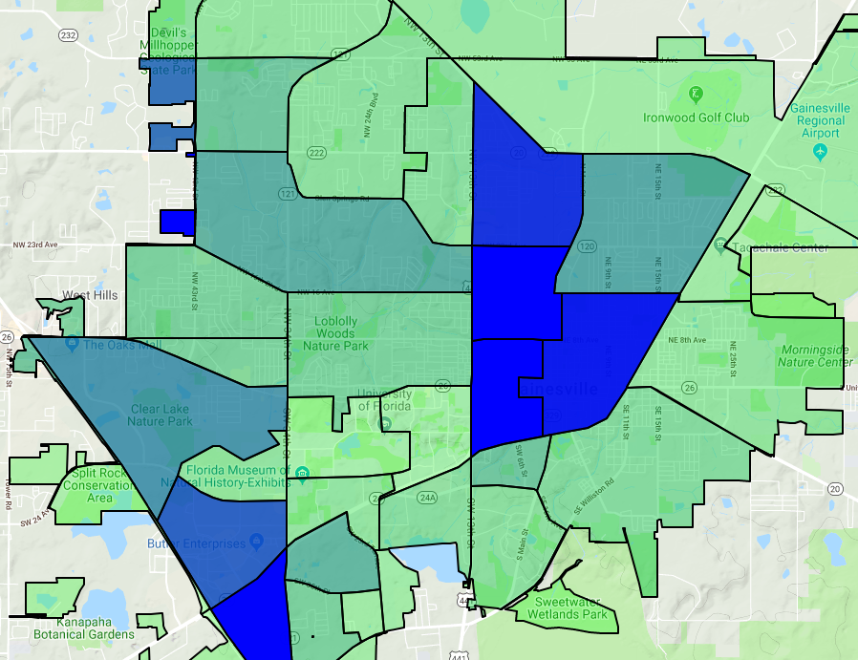

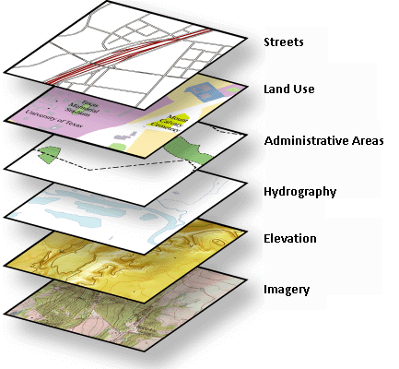






Visualizer for Data-centric Modeling of Gainesville Businesses
Michael Elliott, Parth Patel, José A. B. Fortes
What is it?
A decision support system that operates on datasets of geographic data
Built on the SAGE2 platform
What does it do?
Layers geographic information on a map
Visualizes relationships across data
Multiple users can upload their own data to a shared display wall
GEOJSON
CSV

